Slide 1

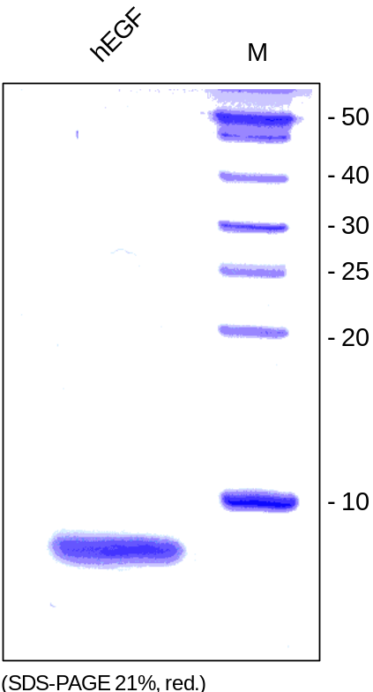
ReliaTech GmbH
Recombinant human EGF
(Cat# 100-009)
Fig. 1: SDS-PAGE analysis of recombinant human EGF produced in E. coli. Sample was loaded in 21% SDS-polyacrylamide gel under reducing conditions and stained with Coomassie blue.
http://www.reliatech.de / orders@reliatech.de

